Slide 1
Loan Risk & Customer Behavior Analysis
Data Analysis with Power BI Final Project
Digital Egypt Pioneers Initiative (DEPI)

Slide 2
Our Team & Resource Allocation
Data Cleaning & Preprocessing
Data Modeling & Schema Design
Data Visualization & UI/UX Layout
Mohamed Hany
Mrawan Said
Malak Elsayed
Shahd Fagelnour
Sandra Bassem
Logain Tamer

Slide 3

Project Proposal & Approach
Core Objective: To analyze loan risk and customer behavior related to loan acquisition, exploring the underlying reasons driving financial decisions.
The Purpose:
Extract meaningful, data-driven insights.
Empower the bank to systematically identify high-risk or unreliable customers.
Structurally improve financial decision-making and minimize credit losses across the portfolio.

Slide 4
Data Origins & Key Beneficiaries
Data Source:
Extracted from an established banking and credit repository hosted on Kaggle.
https://www.kaggle.com/datasets/zaurbegiev/my-dataset
Stakeholders:
Primary (Lenders)
Indirect (Investors)
Utilize the models to objectively evaluate loan applications, lower default rates, and establish optimized lending governance.
Audit macro-level risk exposure and assess portfolio stability prior to capital allocation.

Slide 5
Project Scope & Boundaries
In-Scope (What we focused on):
Analyzing historical loan records to map out default patterns.
Evaluating key demographic and financial risk factors (e.g., Credit Score, Annual Income, Debt-to-Income ratio, Employment Length).
Designing an interactive, multi-page Power BI dashboard for retrospective portfolio analysis.
Out-of-Scope (Setting expectations):
Real-time live data integration (analysis is based on a static historical snapshot).
Predictive machine learning algorithms (focus is strictly on descriptive and diagnostic analytics via DAX).

Slide 6
The Questions We Answered
Credit Health
Financial Capacity
How do varying credit score tiers directly correlate with loan default rates?
What is the exact tipping point where the Debt-to-Income (DTI) ratio makes a loan "high risk"?
Career Stability
Capital Allocation
Does employment longevity significantly impact a borrower's likelihood of repayment?
Which specific loan purposes (e.g., small business, debt consolidation, home improvement) carry the highest financial liability?

Slide 7
Our Implementation Journey
Extraction
Transformation
Safely importing raw, unstructured dataset files (CSV/Excel) into the Power BI environment.
Utilizing Power Query to clean, format, and structure the data for analysis.
Modeling
Visualization
Building the relational schema and programming custom DAX measures.
Designing the front-end user experience to present the insights clearly.

Slide 8
Data Cleaning & Transformation
Standardization
Noise Reduction
Promoted headers, unified column names, and corrected data types.
Filtered out irrelevant data and removed duplicate records.
Data Handling
Text Extraction
Addressed missing values by establishing clear categories.
Cleaned text fields for accurate DAX evaluations.

Slide 9
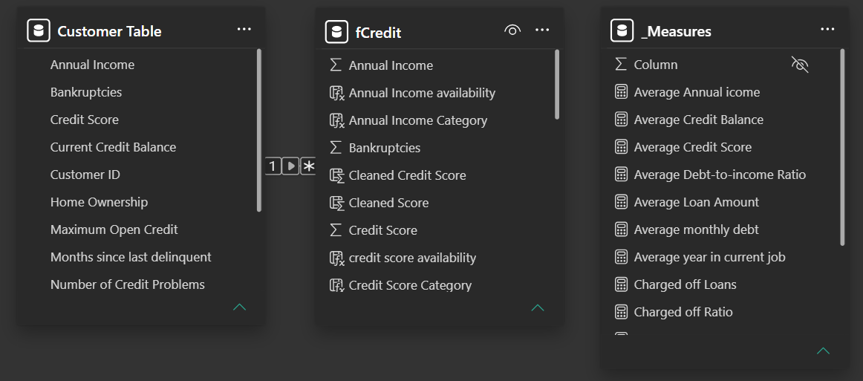
Structuring the Data: Relational Modeling
Transitioned the dataset directly into an optimized analytical model to maximize Power BI's performance.
Separated the flat data into a Dimension Table (Customer Table) for descriptive attributes and a Fact Table (fCredit) for numerical and transactional data.
Established a streamlined 1-to-many relationship (1 -> *) linking unique customer profiles to their corresponding credit records.

Slide 10
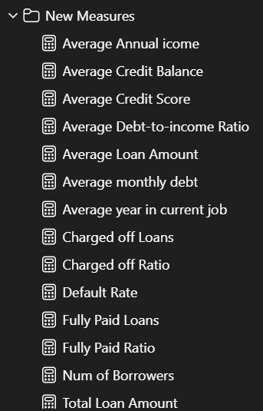
Dynamic Calculations & DAX
Created a dedicated, isolated _Measures table to strictly organize all custom metrics and keep the data model clean.
Relied on dynamic Data Analysis Expressions (DAX) instead of static calculated columns to optimize dashboard speed and interactive filtering.
Key engineered metrics include: Default Rate, Charged Off Ratio, Average Debt-to-Income, and Average Credit Balance.

Slide 11
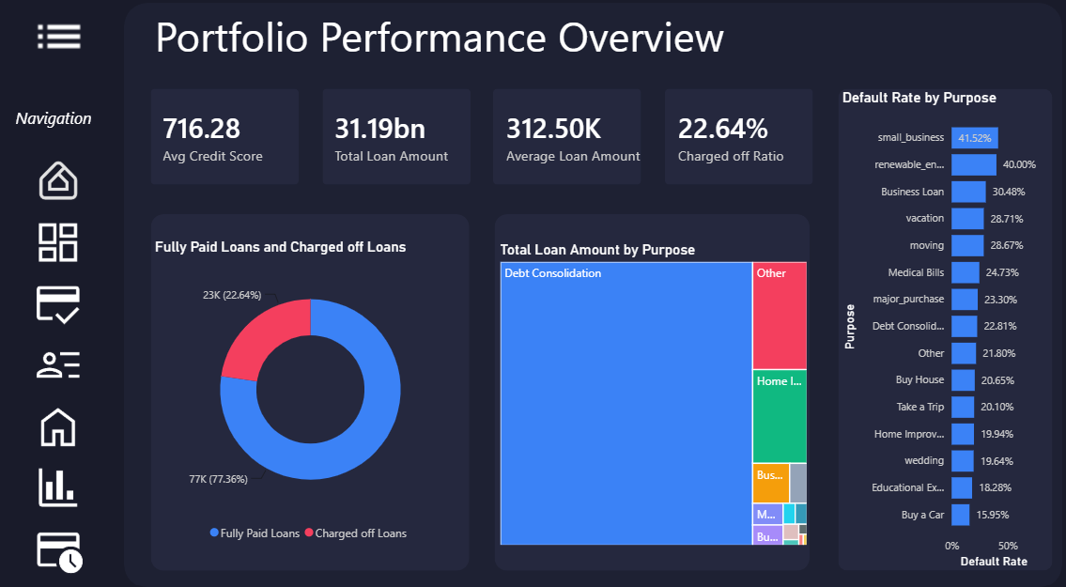
Bringing Data to Life: Visualization Strategy
Developed 6 interconnected dashboard pages, allowing users to drill down from high-level summaries to granular borrower profiles.
Utilized high-contrast, intuitive color coding (e.g., distinguishing 'Fully Paid' vs. 'Charged Off' loans) to make risk assessment immediately visible.
Structured visuals strategically, combining macro KPIs with detailed breakdowns like "Default Rate by Purpose" and "Debt-to-Income" metrics.

Slide 12

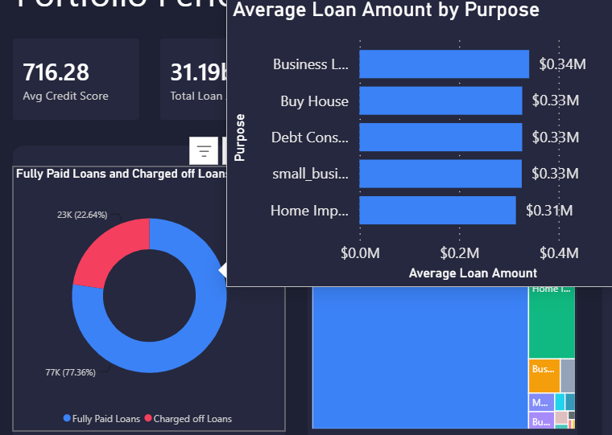
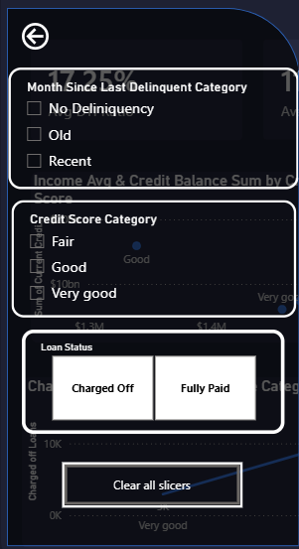
User Experience: Designed for Convenience
Global Navigation: Integrated intuitive, persistent navigation menus across all pages to ensure seamless transitions for the user.
Contextual Tooltips: Embedded custom hover-over tooltips across visuals (e.g., revealing specific driving reasons for loan requests) to provide deep insights without cluttering the main workspace.
Interactive Cross-Filtering: Built context-aware cross-filtering into the charts, allowing stakeholders to dynamically slice the data by clicking on specific metrics or categories.

Slide 13
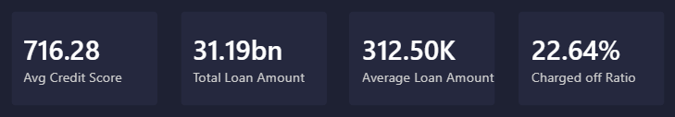

Key Discoveries & Portfolio Insights
Baseline Portfolio Risk: The overall lending portfolio currently experiences a charged-off (default) ratio of 22.64%.
High-Risk Loan Purposes: Loans requested for "Small Business" (41.52%) and "Renewable Energy" (40.00%) exhibit the highest default rates across the portfolio.
Financial Burden Tipping Points: The average Debt-to-Income (DTI) ratio sits at 17.25%. Borrowers demonstrating elevated DTI ratios show clear tendencies toward default.
Employment Stability Factor: Default rates show a progressive decline as the borrower's "Years-in-Job" increases, indicating employment longevity is a strong indicator of repayment stability.

Slide 14
Strategic Credit Policy Recommendations
Enforce DTI Caps
Optimize Credit Approvals
Upgrade underwriting standards and implement more rigorous approval criteria to mitigate the baseline 22.64% default rate.
Establish strict maximum Debt-to-Income caps to limit the bank's exposure to financially over-burdened borrowers.
Risk-Adjusted Mandates
Large Exposure Threshold Controls
Apply stringent terms or demand higher collateral for applicants falling into lower credit score tiers.
Enforce tighter structural conditions and lower maximum ceilings for major capital disbursements, as capital risk escalates with larger loan amounts.

Slide 15

Project Assets & Source Files
GitHub Repository: The central hub for all project files, DAX scripts, and schema documentation.
Power BI Source File: Full .pbix file available for download and local exploration.
Static Report: Complete PDF export of all dashboard views for quick reference without requiring Power BI Desktop.

Slide 16
Interactive Demonstration
A live walkthrough of the user interface, cross-filtering capabilities, and dynamic scenario testing.

Slide 17
Thanks!
Do you have any questions?
Malak Elsayed
Shahd Fagelnour
Sandra Bassem
Logain Tamer
Mohamed Hany
Mrawan Said
Please keep this slide for attribution

